Slide 1
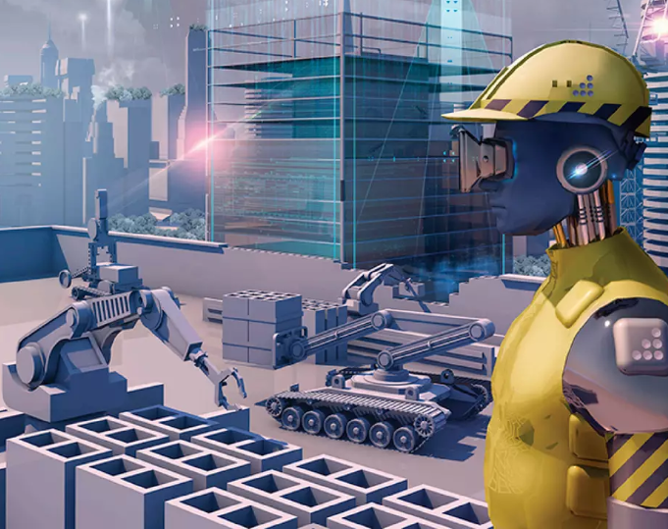
Artificial intelligence in construction and manufacturing
By :-
Sahil(12110224)
Nitesh(12110770 )
Egala(12113426)

Slide 2
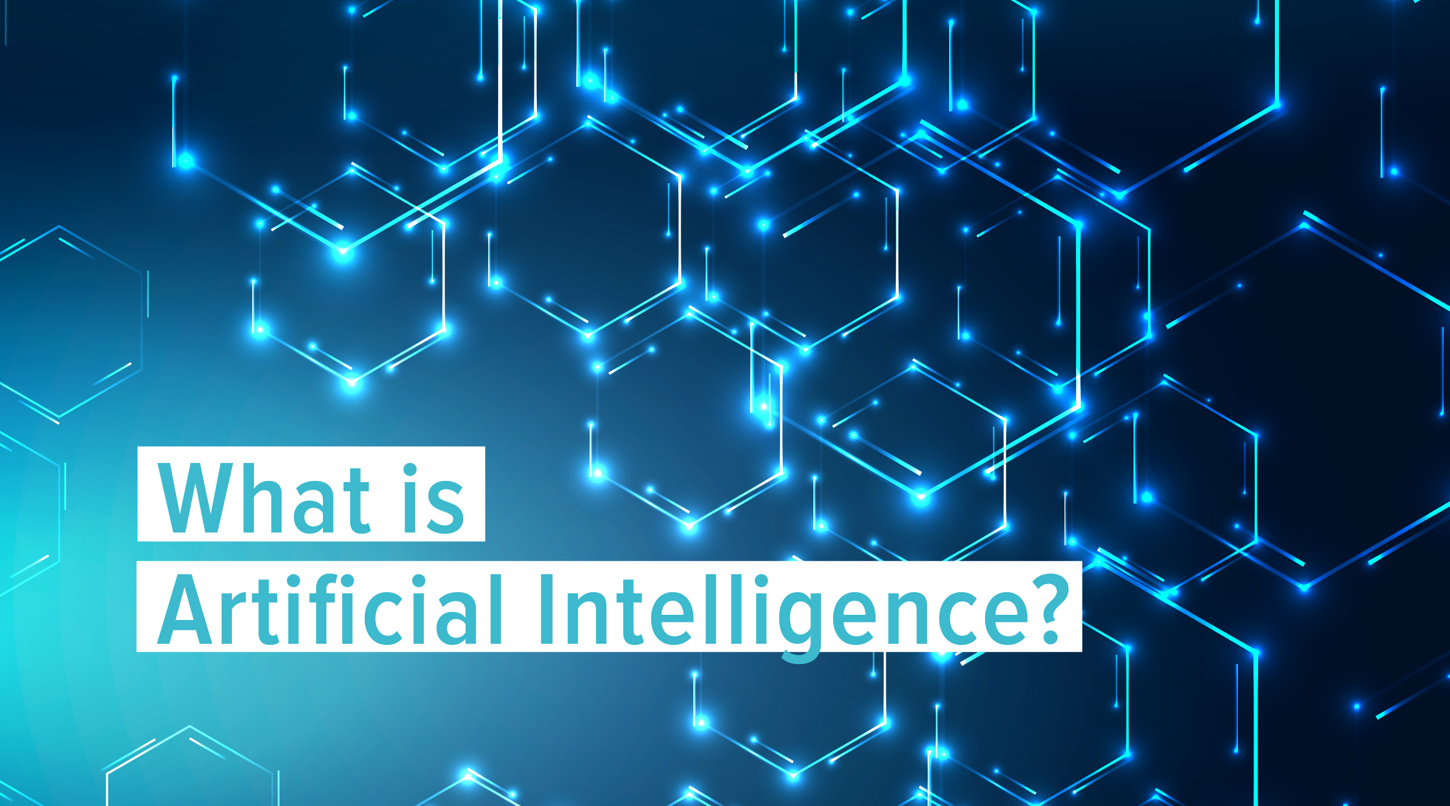

Slide 3
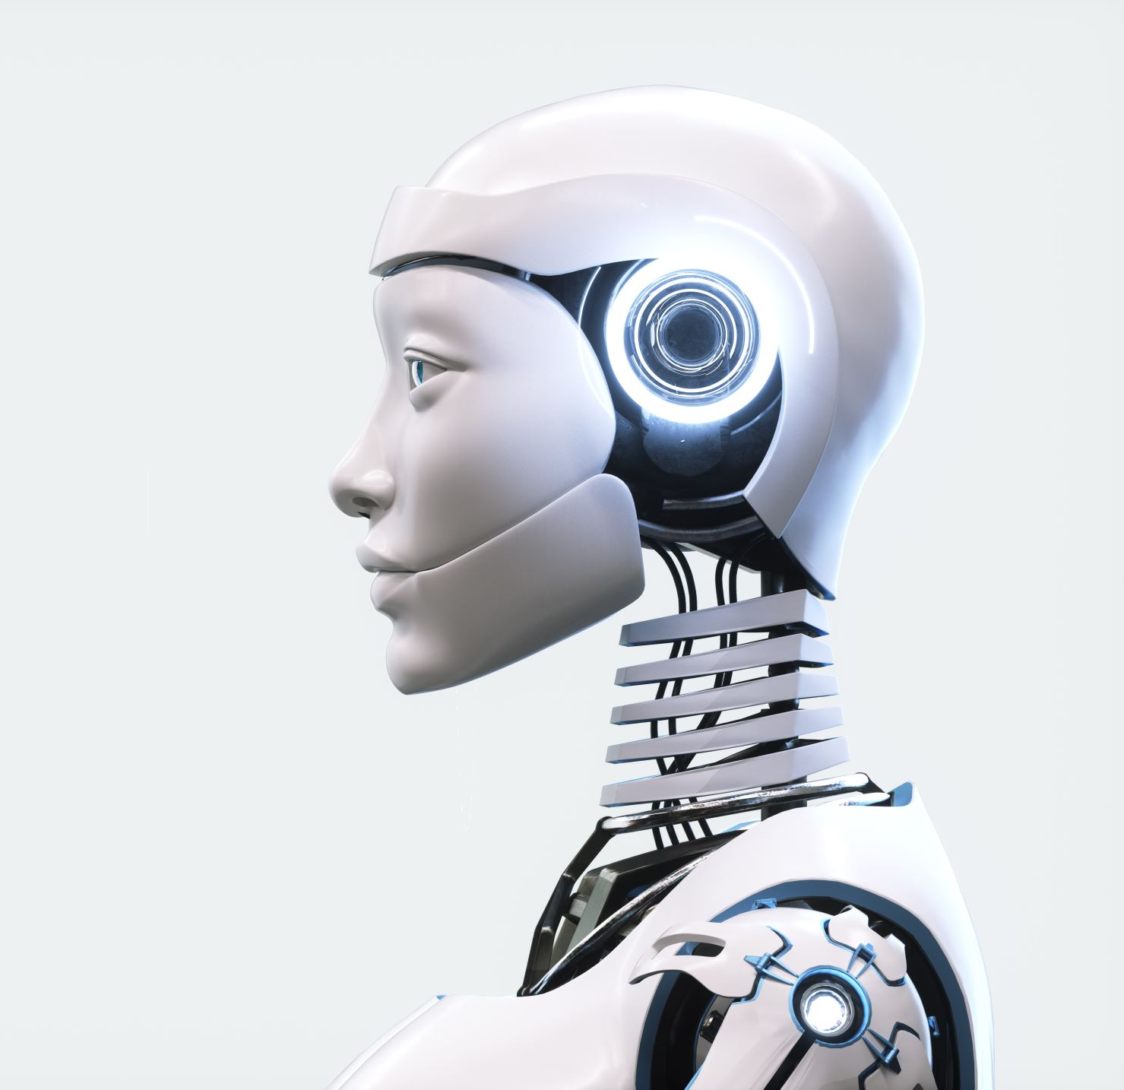
Artificial Intelligence (AI) refers to the simulation of human intelligence in machines that are programmed to think and act like humans. This technology is used to develop intelligent machines that can perform tasks that typically require human intelligence, such as recognizing speech, understanding natural language, making decisions, and recognizing patterns in large data sets.

Slide 4
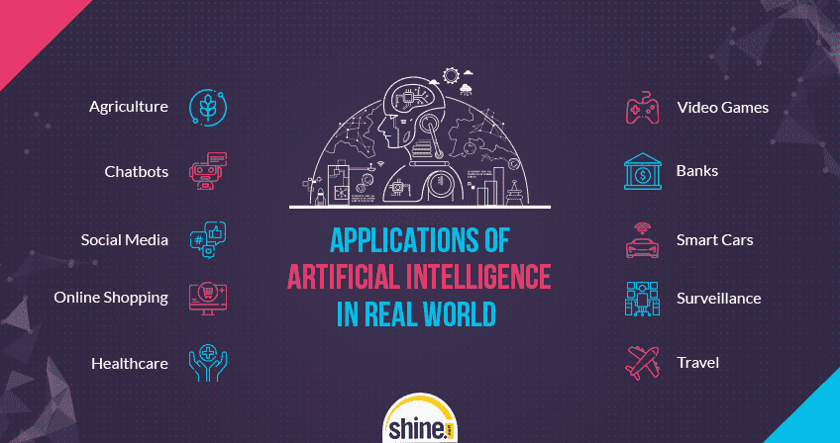

Slide 5
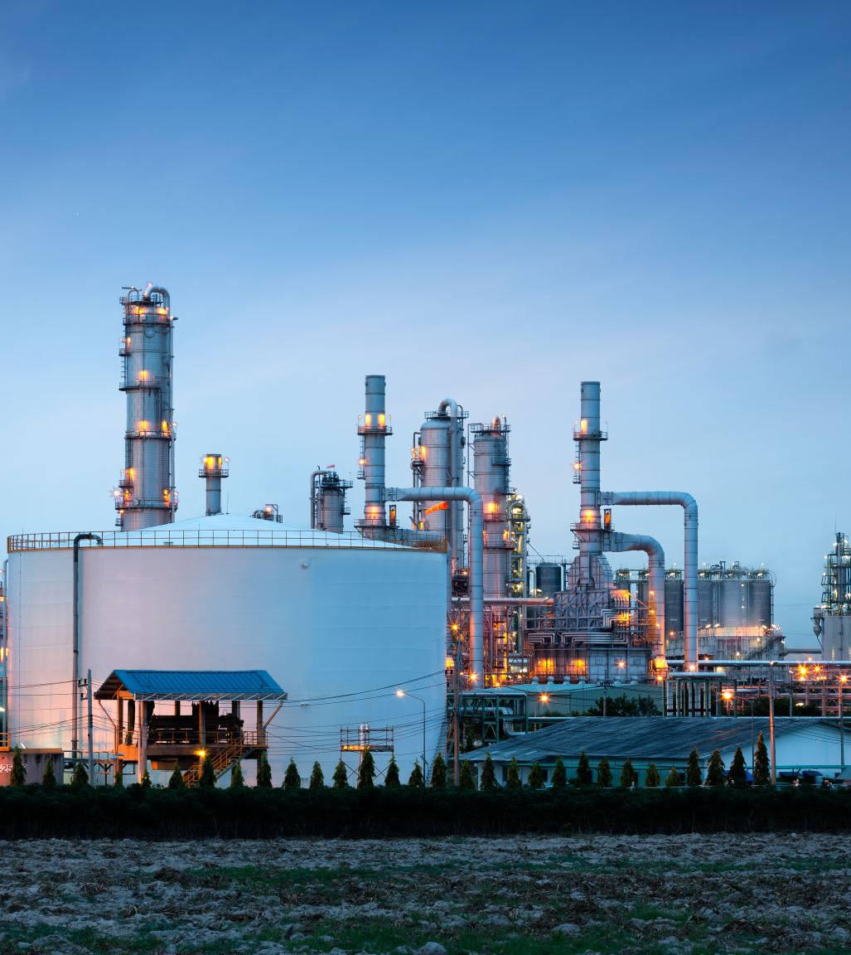
Ai in Construction and manufacturing
Al is being increasingly utilized in the construction and manufacturing industries to improve efficiency, productivity, and safety. Here are some examples:
Quality control
Predictive maintenance
Supply Chain Optimization
Autonomous vahicles and equipment
Building design and optimization

Slide 6
Quality control: Al can be used to detect defects in manufacturing, such as cracks, inconsistencies, or deformities, that may not be visible to the human eye. By using computer vision and machine learning algorithms, Al can quickly and accurately analyze large volumes of data, identify defects, and alert operators to take corrective actions.
Predictive maintenance: Al can help predict when equipment or machinery may fail or require maintenance, allowing for preventative maintenance before any breakdown occurs. This can save time and money, as well as avoid costly downtime.
Supply chain optimization: Al can be used to optimize supply chain management by predicting demand, tracking inventory levels, and identifying potential bottlenecks. This can help reduce waste, optimize logistics, and improve overall efficiency.
Autonomous vehicles and equipment: Al is also being used to develop autonomous vehicles and equipment, such as drones, robots, and self-driving vehicles, which can improve safety and efficiency on construction sites and manufacturing facilities.
Building design and optimization: Al can be used to design and optimize buildings and structures for energy efficiency, safety, and sustainability. By analyzing data on building usage, occupancy, and environmental conditions, Al can recommend adjustments to optimize building performance and reduce energy consumption.

Slide 7
How can Artificial intelligence impact the Construction Industry
Artificial Intelligence is changing the way the construction industry used to process their projects.
The future of AI is booming in the construction industry so that when collaborated with BIM Modeling Services, it can provide model inputs detail to the clients.
AI means the machine or computerized machinery that evince owns intelligence by using algorithms to solve problems using input data.
AI helps to boosts the initial stage of planning and design implementation of aproject for the engineers.

Slide 8
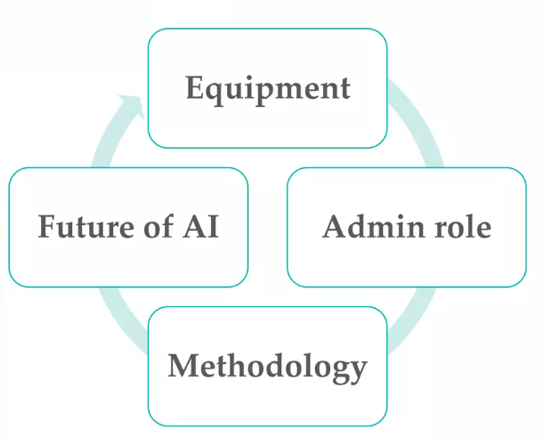
The construction industry uses AI technology in the following ways:
Ai in Planning and equipment
Administrative Roles
Construction methodology
Post-construction

Slide 9

Ai Planning in equipment
Artificial Intelligence is used in the initial stage of construction projects Equipment's that are automated known as Al, which works according to their surroundings and navigation without the need for any input data by the client for the project.
With the help of AI machinery can survey the construction site and collect information to create 3D maps, blueprints, and construction plans.

Slide 10
Administrative Roles
° As the construction begins, Al is used for the management of control tasks and the project.
° For instance, Workers can input vacancies and uncertain departures from the job site into a data system that will adapt the project.
° By this, AI will automate the process of keeping another worker in place and point out the work to them.

Slide 11
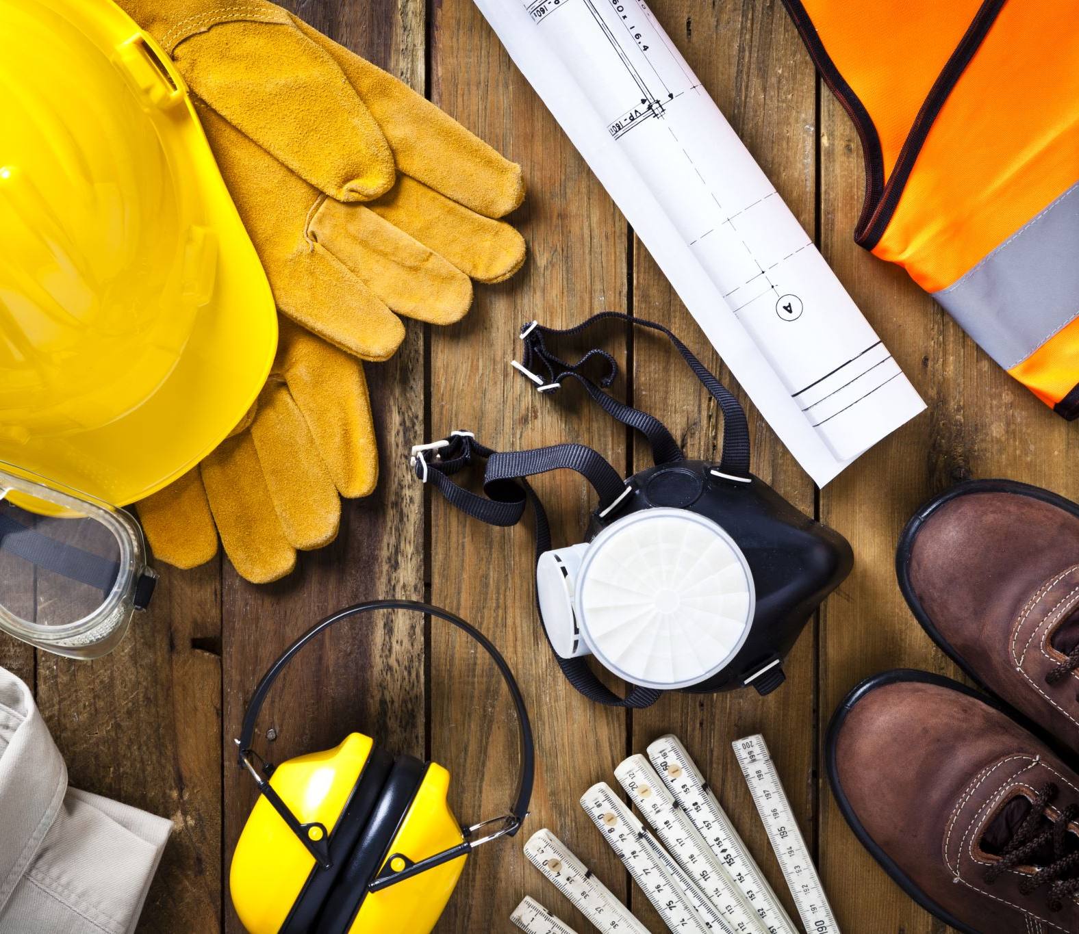
Construction methodology
° AI database systems help to store information on how the project should be evaluated and constructed by the construction professional
° For instance, if the engineers are working on constructing a tunnel, using AI would help him get advice on the process.
° It can verify the pre-existing project and design blueprints and work on the implementation of stages of design.

Slide 12
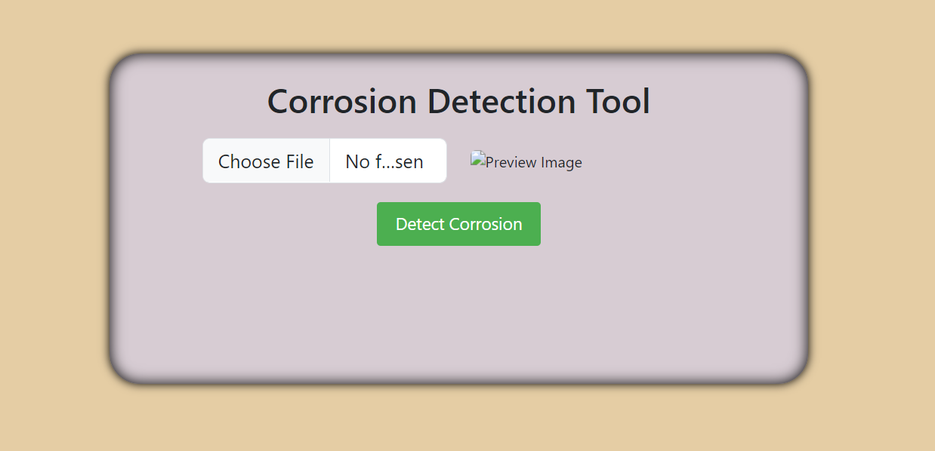
Corrosion detection System
A corrosion detection system is a system used to detect corrosion on a variety of surfaces, such as metal pipes, bridges, and other infrastructure. Corrosion is a chemical reaction that occurs when a metal is exposed to an environment that causes it to break down over time, resulting in damage and potential safety hazards.
A corrosion detection system typically works by using sensors or other types of monitoring devices to measure changes in the surface of the metal. The system can then analyze this data to detect signs of corrosion, such as changes in the metal's electrical conductivity, changes in its surface texture, or changes in its thickness

Slide 13
Language Used
HTML
JAVA SCRIPT
CSS

Slide 14

results

Slide 15
Future of AI
° AI has helped to reimagine how BIM can be used in the construction project in the coming years.
°Al can help construction professionals to manage forecasting, estimation, and scheduling.
° It will also prevent the suggestion of new building development design and ensure high-quality control over materials and design structures.
° AI boosts the productivity of all the traders involved in a project from making a
conceptual model into a construction model.
° It can speed up the construction process and lower the cost of the construction
while enhancing quality and safety measures.

Slide 16

Conclusion
It can also address the problem of safety and inefficiencies.
It will increase the enhancement of data-gathering information and provides a virtual tour of the model being constructed.
If combined with working on other digital technologies, it can increase productivity and make the model accurate and detailed.

